Slide 1
Developing Apps for Touch and Mobile Devices

Slide 2
Objectives
In this session, you will learn to:
  Identify the fundamentals of Azure Mobile Services

Slide 3
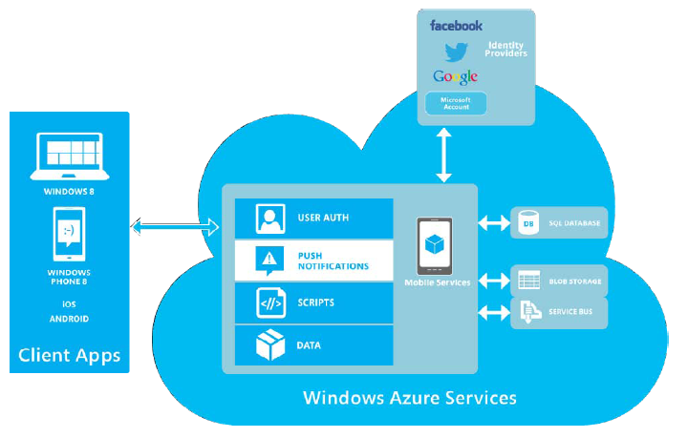
Features of Windows Azure Mobile Services
Microsoft Windows Azure is a cloud-computing platform and infrastructure for building, deploying, and managing applications and services through a global network of Microsoft-managed data centers.
Windows Azure Mobile Services brings together a set of services that enable the developers to add backend capabilities to their apps.
Windows Azure Mobile Services Architecture

Slide 4
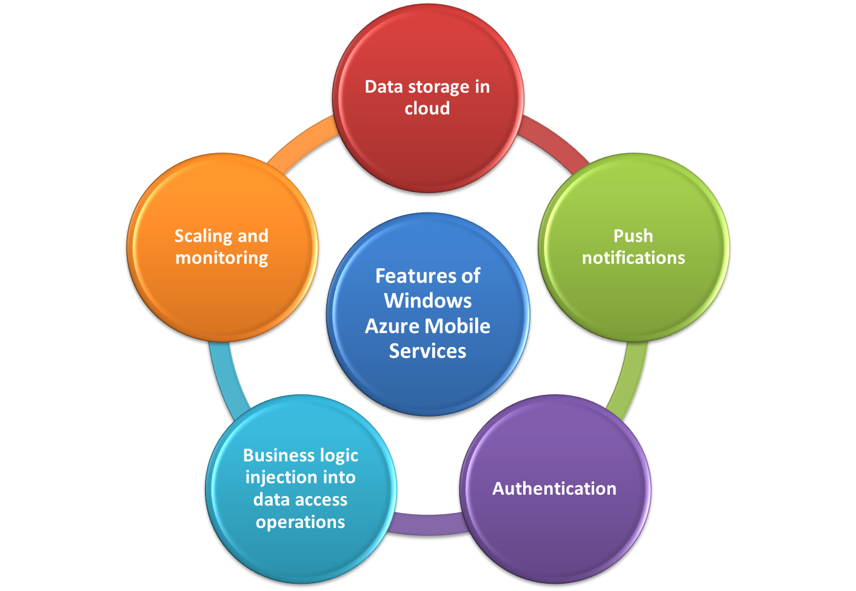
Features of Windows Azure Mobile Services (Contd.)

Slide 5
Features of Windows Azure Mobile Services (Contd.)
Data Storage in Cloud
Windows Azure Mobile Services makes it incredibly easy to connect cloud backend to your client and mobile applications.
Windows Azure Mobile Services:
  Allows you to easily store structured data in the cloud.
  Allows you to access stored data from cloud by devices running apps on different platforms.
  Allows you to store data remotely and access the data from multiple devices.
  Provides a central storage location and helps you synchronize data over multiple devices.

Slide 6
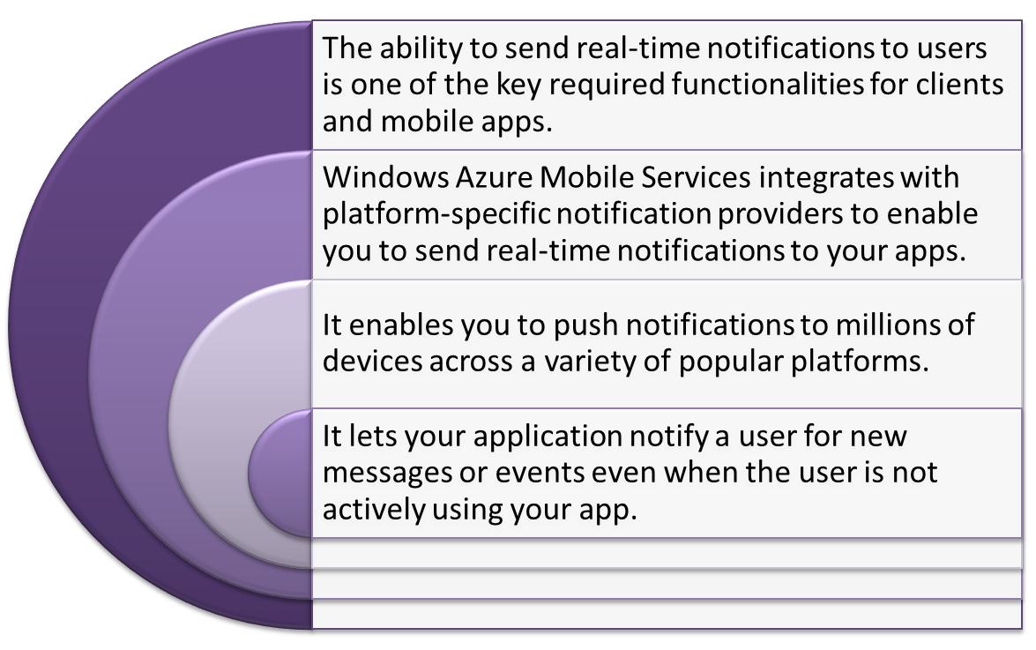
Features of Windows Azure Mobile Services (Contd.)
Push Notifications

Slide 7
Features of Windows Azure Mobile Services (Contd.)
Authentication
Windows Azure Mobile Services enables you to authenticate users from your app, for this you do not need to write, configure, and test custom authentication systems.
Windows Azure Mobile Services integrates with various Identity Providers (IPs) to enable third-party authentication from your mobile apps, such as:
  Microsoft account
  Facebook
  Twitter
  Google
You can allow the users to log in to your app with any of the IPs and Windows Azure Mobile Services handles the authentication for you.

Slide 8
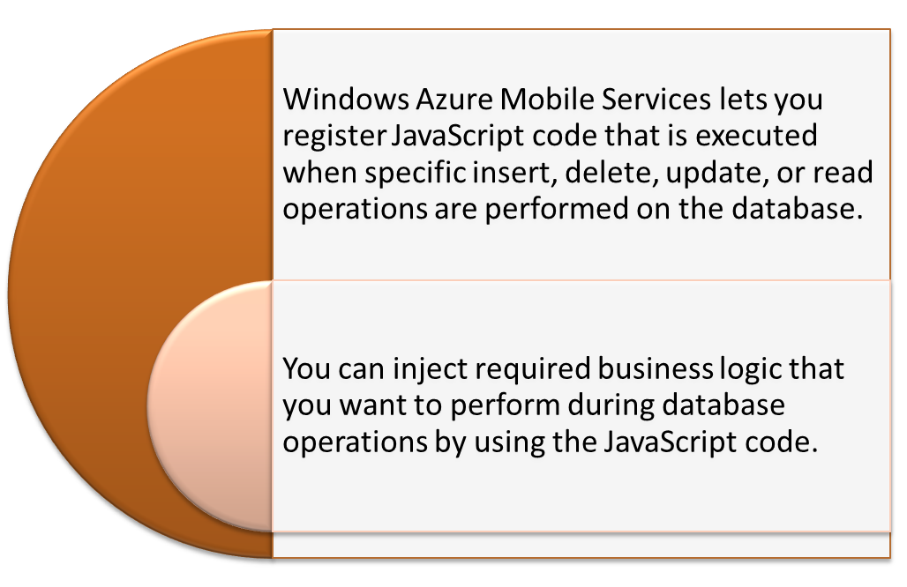
Features of Windows Azure Mobile Services (Contd.)
Business Logic Injection into Data Access Operations

Slide 9
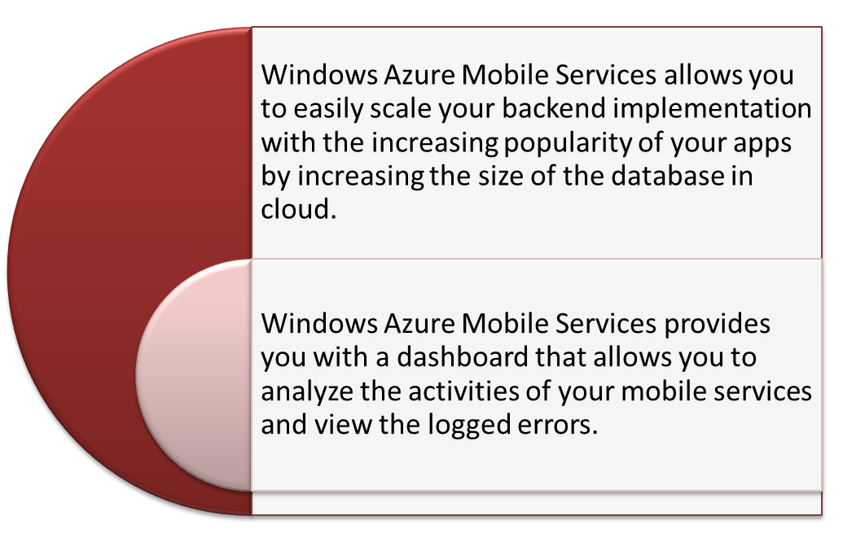
Features of Windows Azure Mobile Services (Contd.)
Scaling and Monitoring

Slide 10
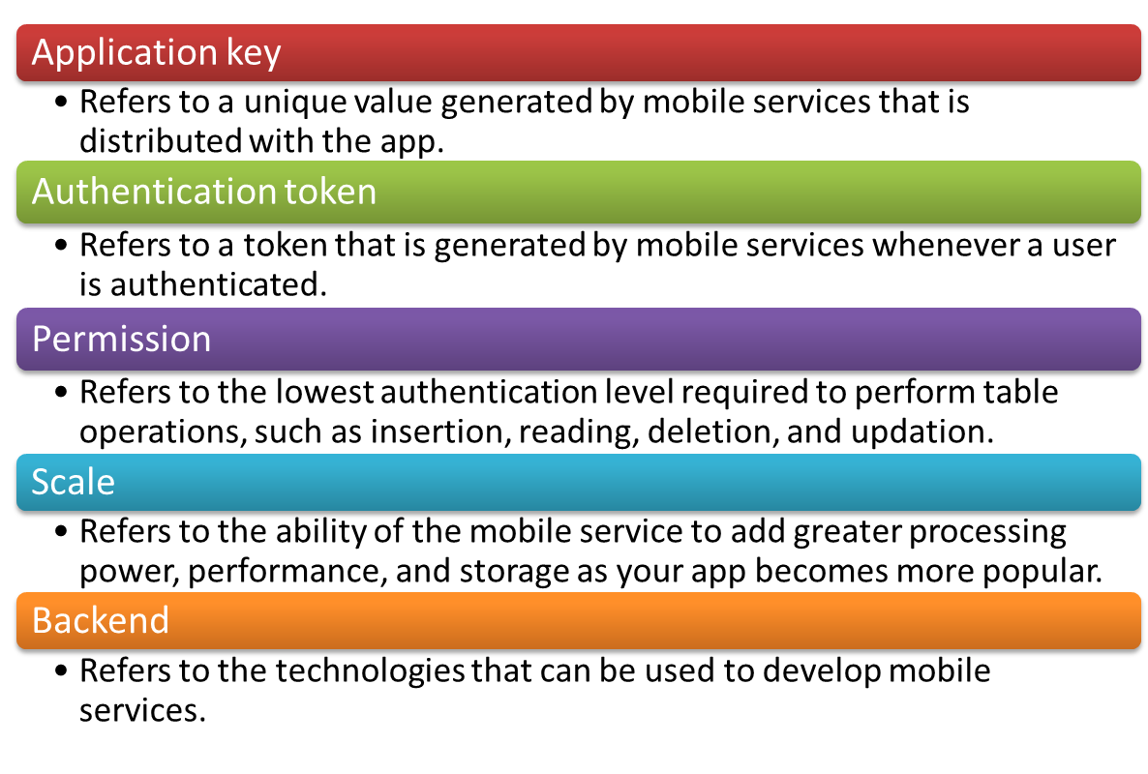
Mobile Services Terminologies
Some of the common terminologies associated with Windows Azure Mobile Services are:

Slide 11
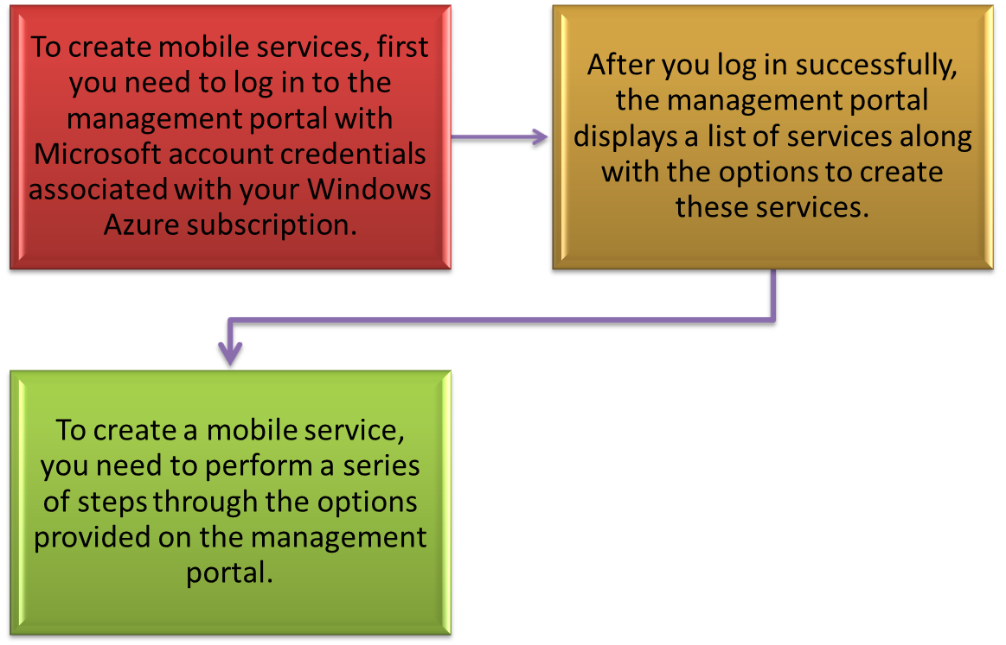
Creating Windows Azure Mobile Services
Windows Azure Mobile Services is accessible from the Windows Azure Management portal.

Slide 12
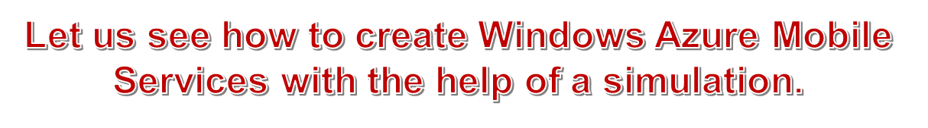
Task 11.1: Creating Windows Azure Mobile Services

Slide 13
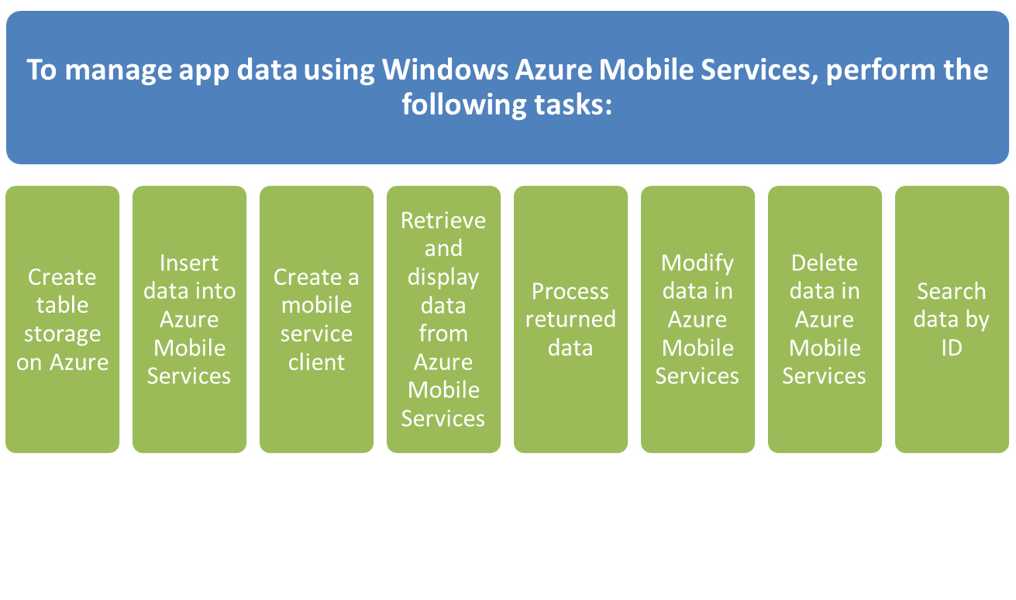
Managing App Data Using Azure Mobile Services
Windows Azure Mobile Services allows you to store app data centrally on a remote cloud server and manage the stored data effectively.

Slide 14
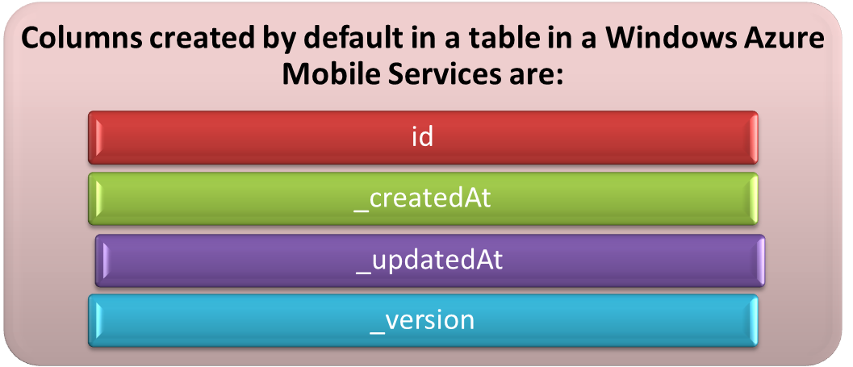
Creating Table Storage on Azure
A database needs to be created while creating Windows Azure Mobile Services to store the app data in cloud.
The database created in cloud can be used to store the data specific to multiple applications.
You need to create required tables in the database and add the columns corresponding to the application data that need to be stored in the cloud.

Slide 15

Task 11.2: Creating Table Storage

Slide 16
Creating a Mobile Service Client
Windows Azure Mobile Services provides a JavaScript client library to access a mobile service instance from a Windows Store app either by using HTML and JavaScript or from an HTML5 Web app.
The client library includes the MobileServiceClient object, which enables a client application to establish a connection with Windows Azure Mobile Services.
The following table lists the commonly used constructors of the MobileServiceClient class.
Constructor | Description
MobileServiceClient(Url) | It is used to initialize a new instance of the MobileServiceClient class with the specified application URL.
MobileServiceClient(String, String) | It is used to initialize a new instance of the MobileServiceClient class with the specified application URL and application key.
Constructors of the MobileServiceClient Class

Slide 17
Creating a Mobile Service Client (Contd.)
The following table lists the commonly used functions of the MobileServiceClient class.
Function | Description
getTable(String) | It is used to get a reference of a table specified as a parameter.
login(string) | It is used to log a user into a mobile services application by specifying an identity provider name, such as Facebook, Google, and Twitter.
logout() | It is used to log a user out of a mobile services application.
Functions of the MobileServiceClient Class

Slide 18
Creating a Mobile Service Client (Contd.)
The following table lists the commonly used properties of the MobileServiceClient class.
To connect a Windows Store app or Windows Phone app to Windows Azure Mobile services, you need to create an instance of the MobileServiceClient class by passing the URL and
application key of your mobile service in JavaScript code.
Property | Description
ApplicationKey | It is used to get or set the application key for the mobile service.
ApplicationUrl | It is used to get or set the URL used to call the mobile service.
CurrentUser | It is used to get or set the authenticated mobile service user.
Properties of the MobileServiceClient Class

Slide 19

Task 11.3: Connecting to a Mobile Service

Slide 20

Inserting Data into a Mobile Service
Once your app is connected to Windows Azure Mobile Services, you can insert the application data into the mobile service.
To implement it, you need to invoke the insert() function by using the MobileServiceTable object, as shown in the following code snippet:
var contactItems = new WinJS.Binding.List();
var contactTable = MyContactBookClient.getTable('Contact');
var insertContact = function (contactItem)
{ contactTable.insert(contactItem).done(function (item)
{contactItems.push(contactItem); }
);
};
bttnAdd.addEventListener("click", function ()
{insertContact
({ name: tbName.value,
phone: tbPhone.value,
email: tbEmail.value,
location: tbLocation.value
});
});

Slide 21

Retrieving and Displaying Data from Azure Mobile Services
The read()function is used to retrieve data from Windows Azure Mobile Services .
While developing the Contact Book application, which allows you to store the contact information in Windows Azure Mobile Services, you can use the read()function to retrieve data from the Contact table.
var refreshContactItems = function ()
{
Contact table;
contactTable.read().done(function (results)
{
contactItems = new WinJS.Binding.List(results);
listItems.winControl.itemDataSource = contactItems.dataSource;
});
};
bttnRefresh.addEventListener("click", function ()
{ refreshContactItems();
});

Slide 22
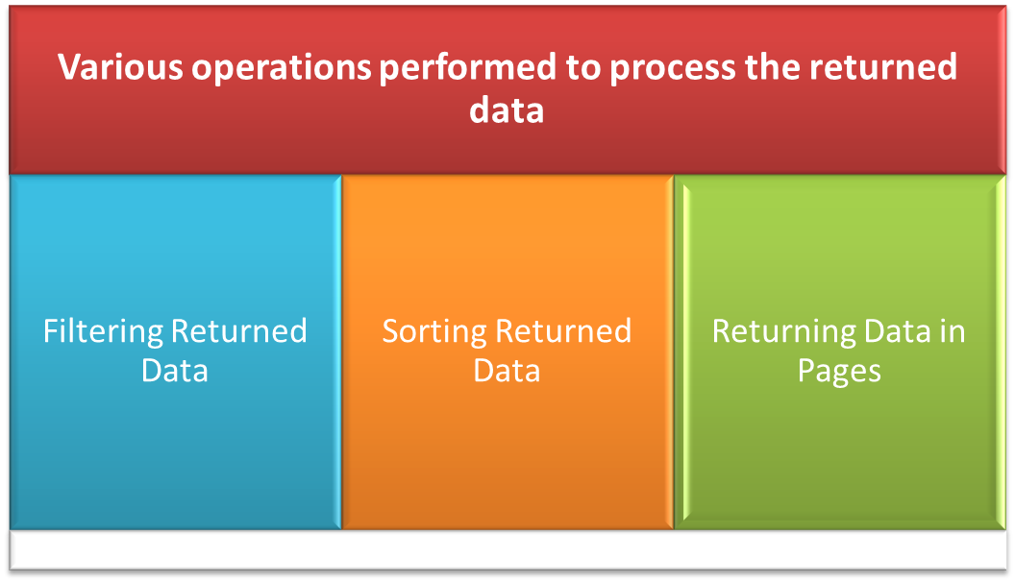
Processing Returned Data
When you invoke the read() function on a mobile service table object, the function retrieves the entire data available in the table.
Often while using an app, you may need only a subset of the table data, you may also need data from the mobile service table in a specific order.

Slide 23

Processing Returned Data (Contd.)
Filtering Returned Data
To create apps such as Contact Book application, the users need to search for a particular contact by name.
To accomplish the preceding task, you can filter the data returned from the read() function.
var searchContactItems = function ()
{ contactTable.where({ name: tbSearchText.value })
.read().done(function (results) {
contactItems = new WinJS.Binding.List(results);
listItems.winControl.itemDataSource = contactItems.dataSource;
},
function (error) { });};
bttnSearch.addEventListener("click", function ()
{searchContactItems(); });

Slide 24

Processing Returned Data (Contd.)
Sorting Returned Data
While retrieving data from a mobile service table, you can sort the data and display it in ascending or descending order based on the value of a column.
The orderBy clause sorts the data in ascending order.
The orderByDescending clause sorts the data in descending order.
The following code snippet shows the use of the clauses:
var refreshContactItems = function ()
{
Contact table; contactTable.orderByDescending("name").read().done(function (results)
{
contactItems = new WinJS.Binding.List(results);
listItems.winControl.itemDataSource = contactItems.dataSource;
});
};

Slide 25

Processing Returned Data (Contd.)
Returning Data in Pages
Pagination is the technique to display the records across multiple pages and provide an option to switch among the pages.
To display the retrieved records in this manner, you need to be able to consider and skip certain rows from the table.
The take clause helps you to retrieve a specified number of rows from the beginning of a record set.
The skip clause helps you to omit the specified number of rows from the beginning of a record set while retrieving data.
var refreshContactItems = function () {
table;
contactTable.take(4).read().done(function (results) {
contactItems = new WinJS.Binding.List(results);
listItems.winControl.itemDataSource = contactItems.dataSource;
});
};

Slide 26
Summary
In this session, I learned that:

